Slide 1


Enhanced Low SNR Radio Signal Classification using Deep Learning
Final Presentation
AI Wireless
M Farhan Tandia (0860814),
Ivan Surya H (0860812) - 3
National Chiao Tung University, Taiwan

Slide 2
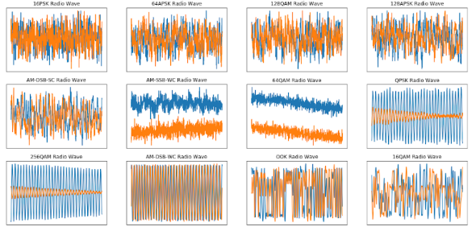

BACKGROUND
Signal modulation used to transmit a signal is important. Spectrum interference monitoring, radio fault detection, dynamic spectrum access, etc.
Traditional signal classification need to extract some features. Fourier Transform, SIFT, MFCC, or another handcrafting method using statistical modulation features.
Defense Application Radio signals may reveal vital information regarding the detection, localization, and identification of an opponent. Traditionally, operators who were trained to recognize various signal formats based on manual ‘listen in’ techniques performed the identification.

Slide 3



PROBLEM STATEMENTS
What is the new state of the art of deep learning needs to be chosen and suitable for radio signal classification?
How we could make use of a large dataset to classify the RAW signal using the new state of the art of deep learning network?
How we could do a benchmark comparison with the previous state of the art method?
Notes:
Problems
What are the problems that you are trying to solve?
Why are the problems important?

Slide 4
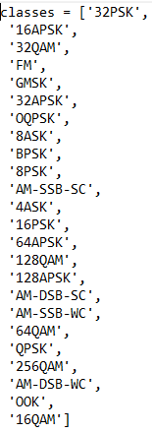
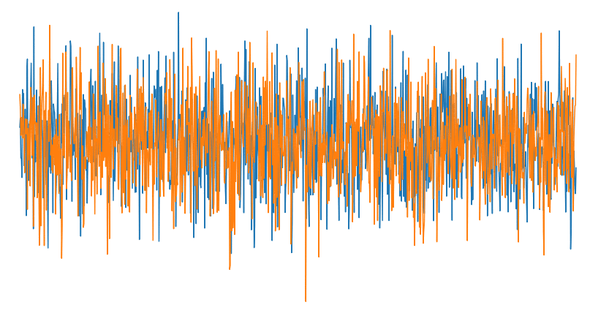
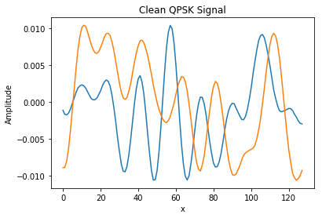
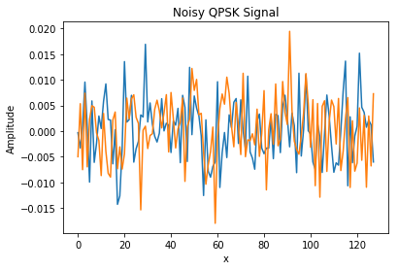
CHALLENGES
In the image below, we can see how drastically noise can affect our ability to recognize a signal.
We should be able to classify signals both in low SNR and high SNR.
We use the DeepSig Radio Signal Dataset, this dataset is pretty large (18GB). We will use 1.5 Million variation of signal modulation with respect to the SNR value.
DeepSig Dataset ,2018
High VS Low
SNR
Notes:
In reality, the signal is always not ideal and combined with unwanted signal that is considered as noise.
A clean signal will have a high SNR and a noisy signal will have a low SNR.
Challenges
What are the limitation of current approaches?
What are the differences between these prior approaches and your proposed?

Slide 5
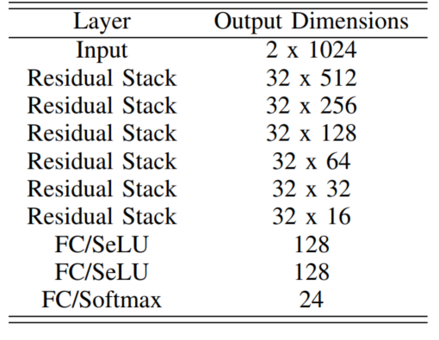
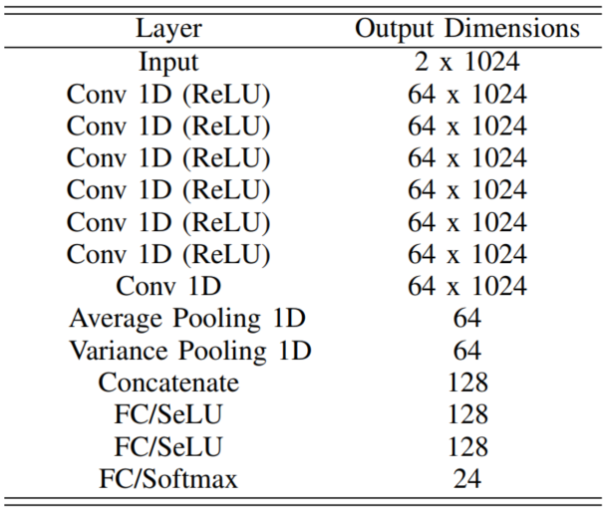
PREVIOUS METHOD
FOCUS ON HIGH SNR
Baseline ResNet Architecture [1]
Maximum Accuracy : 93.7 %
X-Vector Architecture [2]
Maximum Accuracy : 98%
[1] T. J. O’Shea, T. Roy and T. C. Clancy, "Over-the-Air Deep Learning Based Radio Signal Classification," in IEEE Journal of Selected Topics in Signal Processing 2018
[2] Harper, Clayton A., et al. "Enhanced Automatic Modulation Classification using Deep Convolutional Latent Space Pooling." ASILOMAR Conference on Signals, Systems, and Computers. 2020.

Slide 6
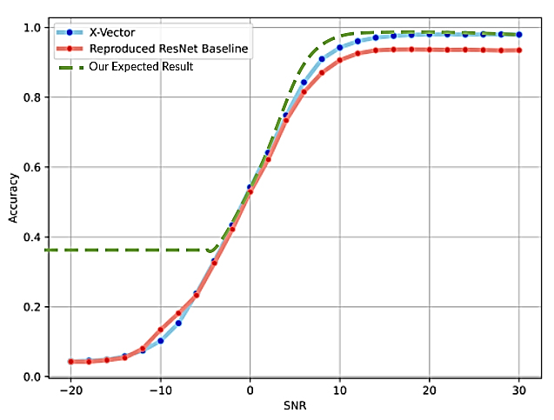
GOALS
Get higher accuracy in lower SNR value.
Design a new deep learning architecture and try to get the comparable results in terms of accuracy with state of the art or even better.
End-to-end Deep Learning Model System (using only RAW signal).
Get a comparable result
on High SNR Classification
Accuracy.
Increase Low SNR
Classification Accuracy
Notes:
It will indicate that our model is robust under the noisy signal modulation.
Goal
What is your key concept and its unique and novelty? What are the expected advantages?
the X-Vector approach begins to outpace the ResNet model beginning around a 6dB SNR value.

Slide 7
PROPOSED METHOD
Notes:
Goal
What is your key concept and its unique and novelty?
What are the expected advantages?

Slide 8
High SNR Model
ResNet Modified

Slide 9
Low SNR Model
Transformer

Slide 10
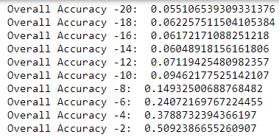
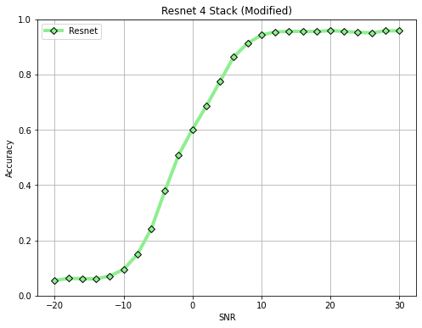
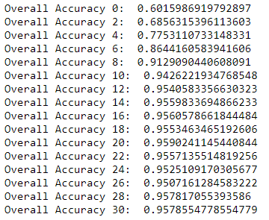
Key Result High SNR (ResNet)

Slide 11
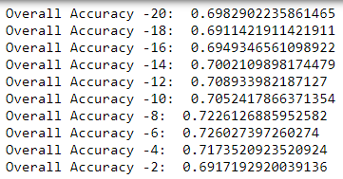
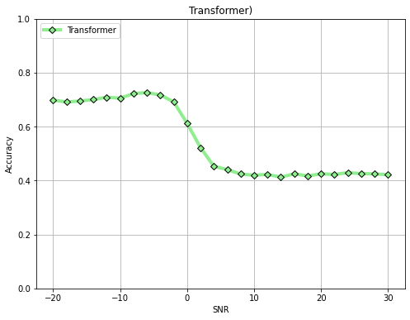
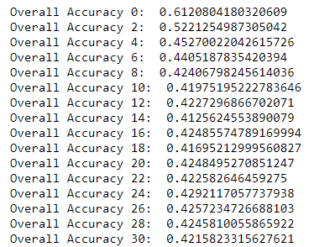
Key Result Low SNR (Transformer)

Slide 12
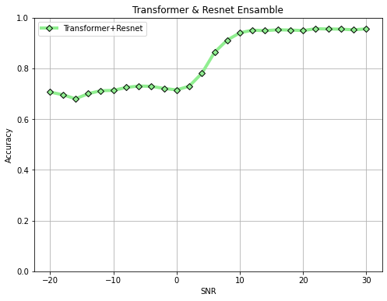
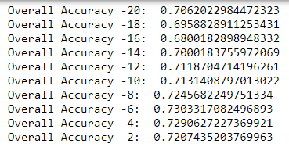
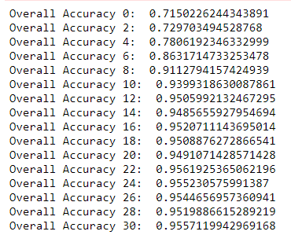
Key Result (Ensemble)

Slide 13
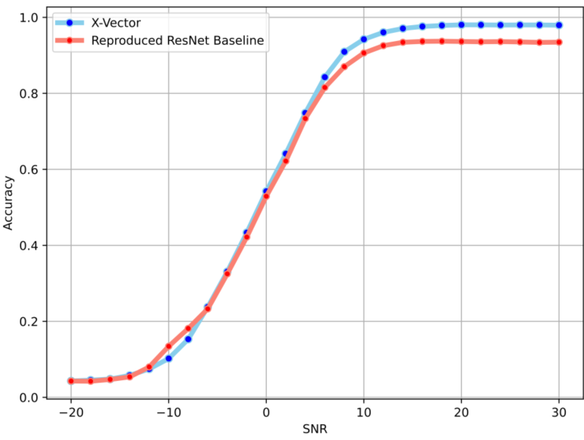
Comparison with SOTA (Accuracy)
High SNR (maximum accuracy)
X-Vector : 98%
Resnet Baseline : 93.7%
Resnet Modified : 95 %
Low SNR (-20,0)
X-Vector : 17%
Resnet Baseline : 14%
Transformer: 70.0 %

Slide 14
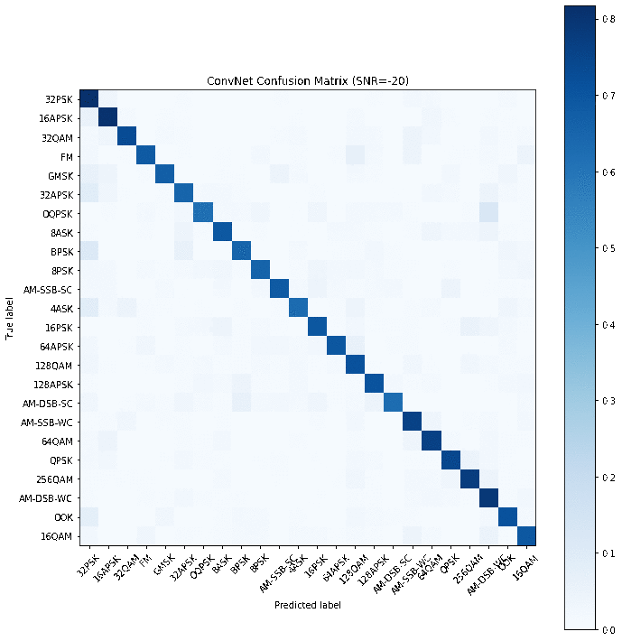
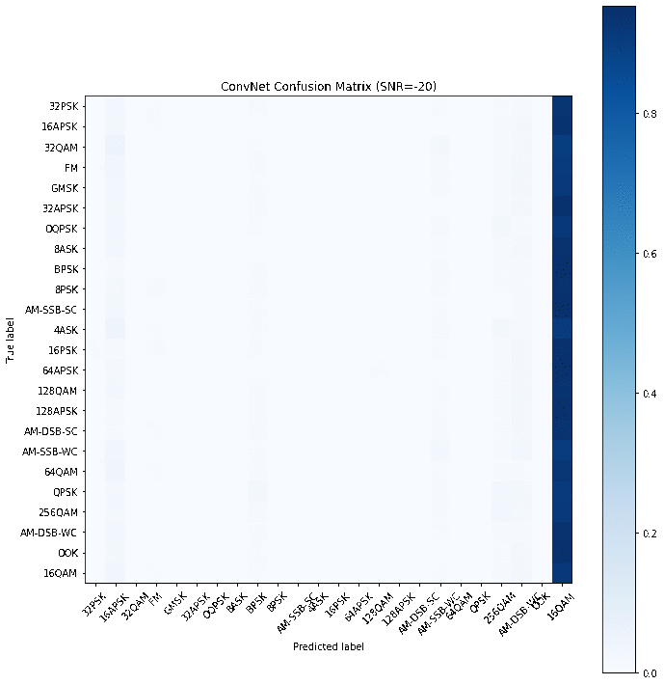
Comparison with SOTA (Confusion Matrix)

Slide 15
CONCLUSION
We show that using ensemble method our classifier can learn the signal not only for high SNR but also low SNR.
Transformer model can achieve up to 70% accuracy at low SNR values which is a big improvement in comparison with previous approach.
Our modified ResNet get higher accuracy than the baseline model
We successfully make a new

Slide 16
Thank you
☺

Slide 17
Key References
T. J. O’Shea, T. Roy and T. C. Clancy, "Over-the-Air Deep Learning Based Radio Signal Classification," in IEEE Journal of Selected Topics in Signal Processing, vol. 12, no. 1, pp. 168-179, Feb. 2018, doi: 10.1109/JSTSP.2018.2797022.
Harper, Clayton A., et al. "Enhanced Automatic Modulation Classification using Deep Convolutional Latent Space Pooling." ASILOMAR Conference on Signals, Systems, and Computers. 2020.
J. Uppal, M. Hegarty, W. Haftel, P. A. Sallee, H. Brown Cribbs and H. H. Huang, "High-Performance Deep Learning Classification for Radio Signals," 2019 53rd Asilomar Conference on Signals, Systems, and Computers, Pacific Grove, CA, USA, 2019, pp. 1026-1029, doi: 10.1109/IEEECONF44664.2019.9048897.
S. Huang et al., "Automatic Modulation Classification Using Compressive Convolutional Neural Network," in IEEE Access, vol. 7, pp. 79636-79643, 2019, DOI: 10.1109/ACCESS.2019.2921988.
Huynh-The, Thien & Hua, Cam-Hao & Pham, Quoc-Viet & Kim, Dong-Seong. (2020). MCNet: An Efficient CNN Architecture for Robust Automatic Modulation Classification. IEEE Communications Letters. 24. 811-815. 10.1109/LCOMM.2020.2968030.

